Slide 1
Oncology Research & Quality Improvement Datamart (ORQID)
Peter E. Gabriel, MD, MSE

Slide 2
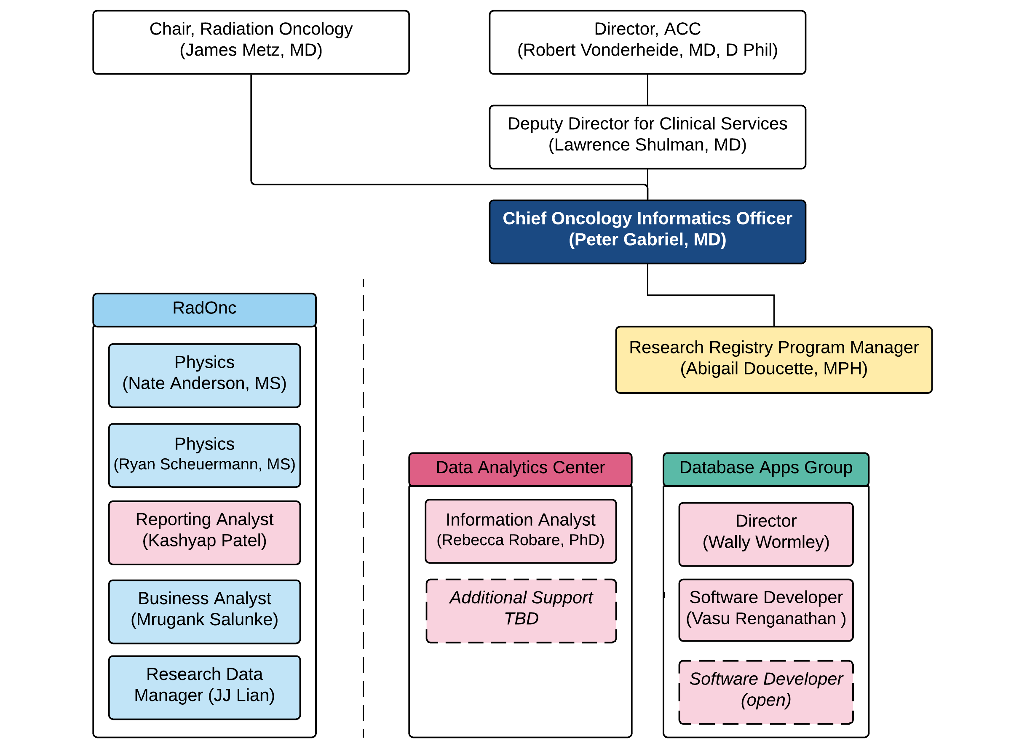
Virtual “Oncology Analytics” Team

Slide 3
Oncology Analytics Goals
Mission: Improve cancer care and research through more effective organization and use of clinical data
How are we different than the IS Data Analytics Center (DAC)?
Trying to provide a higher level of service for the cancer service line by developing and leveraging our deep oncology domain knowledge
How are we different than IBI Clinical Research Informatics Core (CRIC)?
Support clinical, quality, and operational analytics needs in addition to research
How are we different than Strategic Decision Support (SDS)?
Focused on clinical data for clinical quality and research use cases (not financial data)

Slide 4
ORQID Goals
Primary Goals:
Aggregate from source clinical systems the most useful structured data relevant to oncology research and quality improvement
Scrub / clean / normalize / transform / standardize / map / categorize / decode the data to enrich it and dramatically simplify querying & interpretation
Not in Scope:
‘omic research data (raw NGS data, RNA seq, etc.)
Unstructured text

Slide 5
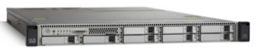




ORQID Overview
Velos
Cancer Registry
ARIA
Live
Planned
Clinical Trial Enrollment
RT Course Details
Dose, Fractions
DVH Data
Detailed Dx & Stage
Histology, Nodes, Margins, etc.
Summary of First Course of Rx
Tumor Control, Vital Status
LabVantage, etc.
Biospecimens
ORQID
Vital Status
Lines of Therapy
[Progression]
Risk Factors & Biomarkers
Demographics
Vital Status
Visit Details
Toxicities
Performance Status
Chemo & Systemic Therapy
Hospice episodes
Cancer Surgeries
Patient-Reported Outcomes
ED visits, hospitalizations
Somatic Genomic Variants
Flatiron
Reference Dictionaries:
ICD-9/10 cancer diagnosis codes
ICD-O-3 primary site & histology codes
NAACCR cancer registry codes
CSL practice & provider dictionaries
Antineoplastic drugs
Epic
CPD
Available by database link:
Imaging orders
Lab results
Everything else in Epic

Slide 6
Current Stats
~100 tables, ~10 views, ~60 stored procedures, ~15GB
Cancer Registry:
~117K unique patients with ~140K hospital-specific tumor case reports
Epic:
~450K patients with ~3.5M visits to CSL Epic departments
~47.5K Beacon treatment plans with ~560K antineoplastic drug infusions
~165K CTCAE toxicity and ~375K performance status assessments
Aria:
~26K patients with ~32K radiation treatment courses
~12K complete sets of radiation dose-volume histogram data
CPD:
~8800 patients with ~12K tests and ~29K variants

Slide 7
History of Technology / IT Collaboration
ETL
ETL
SQL stored procedures over linked servers
IBM DataStage ETL jobs
RIDIC
MS SQL Server
~2010 – 2016
Pete
ORQID v1
SAP HANA
~2016 – 2017
Pete + DAC
ETL
ORQID v2
MS SQL Server
Pete + DAC
SQL stored procedures over linked servers;
select DataStage jobs
MS SQL Server “Cluster”

Slide 8
Current Technical/Development Support
MS SQL Server Database Administrators (DBAs)
Aimee O’Donnell, Bill Bergen, Joe Haines
Data Analytics Center
Eric Juhn (data architect, currently providing limited support)
Likely will be hiring or identifying a new data architect / database developer

Slide 9
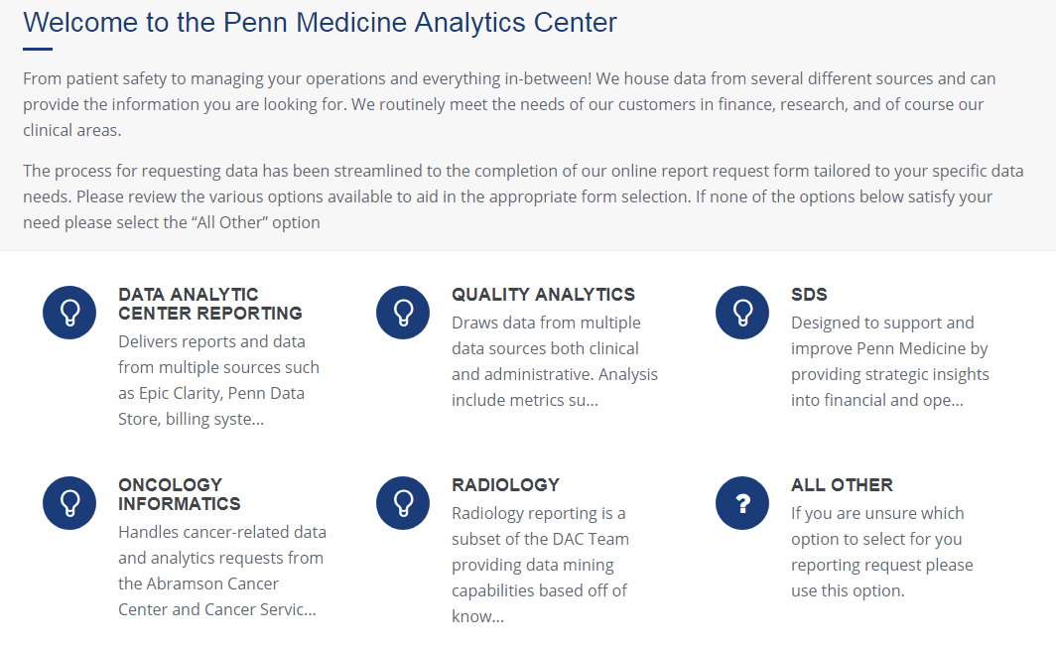
Our Processes - Intake
Analytics Requests: https://uphsnet.uphs.upenn.edu/DACReportRequest/

Slide 10
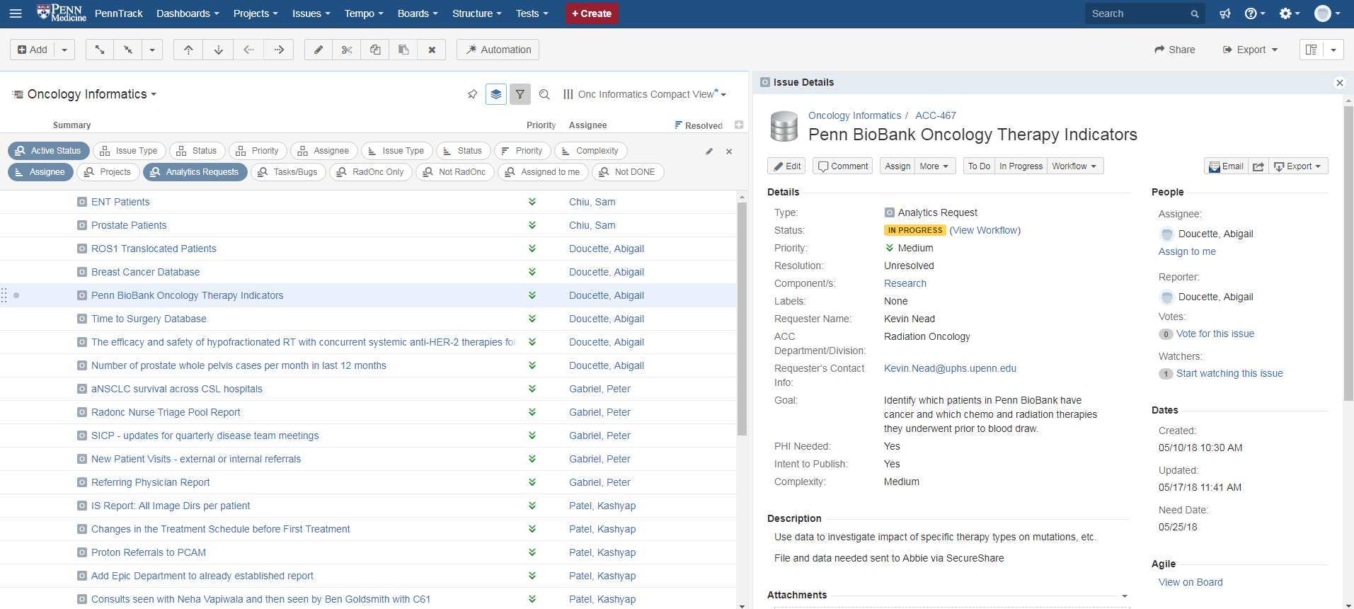
Our Processes - Tracking
http://penntrack:8080

Slide 11
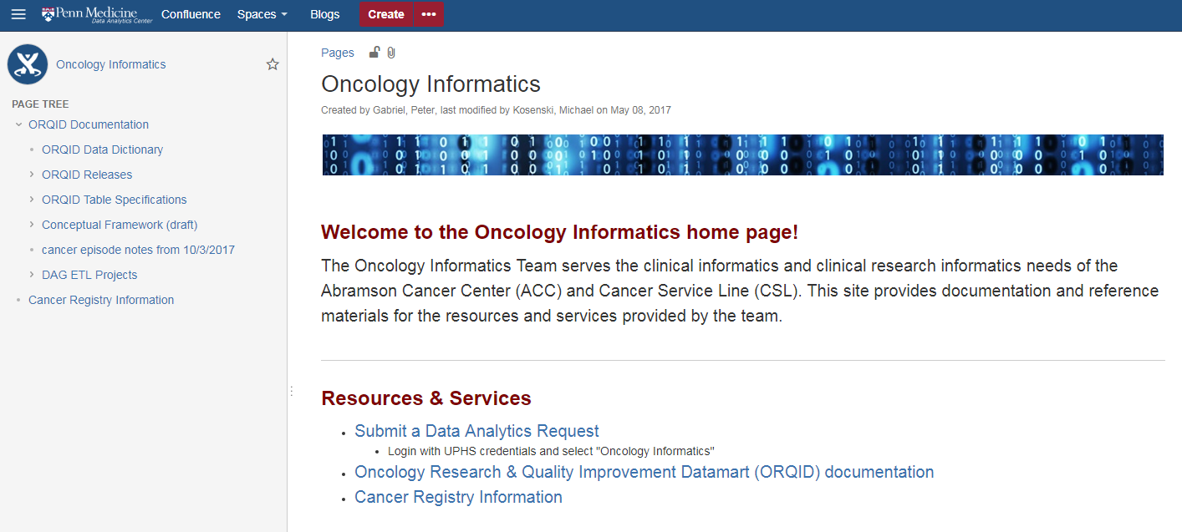
Our Processes - Documentation
http://confluence:8090/display/OI/Oncology+Informatics

Slide 12
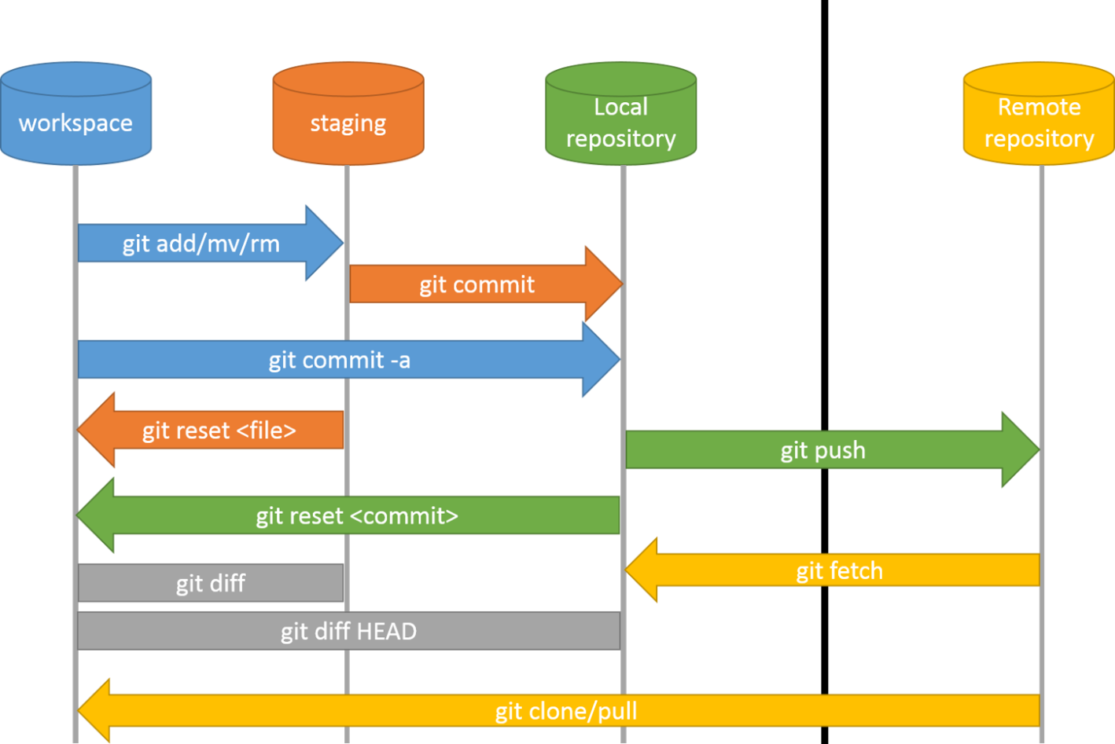

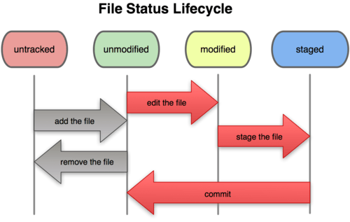
Our Processes – Git Version Control

Slide 13
ORQID Connection Details
ORQID Production
Accounts
Your Windows AD accounts
ORQID_ReadWrite
Tableau_User
BOE_User
webservice_user
Server: UPHVDBNDC049A
Database: ORQID
ORQID Development
Server: UPHVDBNDC048B\SQL2
Database: ORQID
Linked Servers
Flatiron
L_CLARITY_PROD.clarity_snapshot_db
L_CLARITY_PROD.Clarity_Custom_Tables
L_ARIA_PROD.VARIAN
L_ARIA_REPORT.VARIAN
L_METRIQ.ppmc_reg
Server: UPHVDBNDC049A
Database: FLATIRON

Slide 14
MS SQL Server 101
Main Database Objects:
Table (stores data physically on disk)
View (saved query)
Stored procedure (executable program)
Index (enables efficient searching of tables)
Constraint (data integrity rule)
MS SQL Server “fully qualified” syntax for object names:
[server].[database].[schema].[object]
E.g. UPHVDBNDC049A.ORQID.epic.PATIENT
L_CLARITY_PROD.clarity_snapshot_db.dbo.PATIENT

Slide 15
ORQID Schemas
aria – data sourced from Aria database
cpd – data sourced from Center for Personalized Diagnostics
cpr – “confidential / peer review” data from RadOnc – e.g. Chart Rounds and CRS data
dbo – data from miscellaneous and/or multiple sources
epic – data sourced from Epic
etl – stored procedures and logs for “extract, transform, load” operations to bring in new data from sources
mdm – “metadata management” – dictionaries and lookup tables for decoding data from multiple sources
metriq – data sourced from the Penn Cancer Registry
redcap – data sourced from REDCap projects
res – research cohorts and data sets (often temporary)

